Slide 1
THE
USER INTERFACE
for
FLOOR PLAN MANAGEMENT

Slide 2
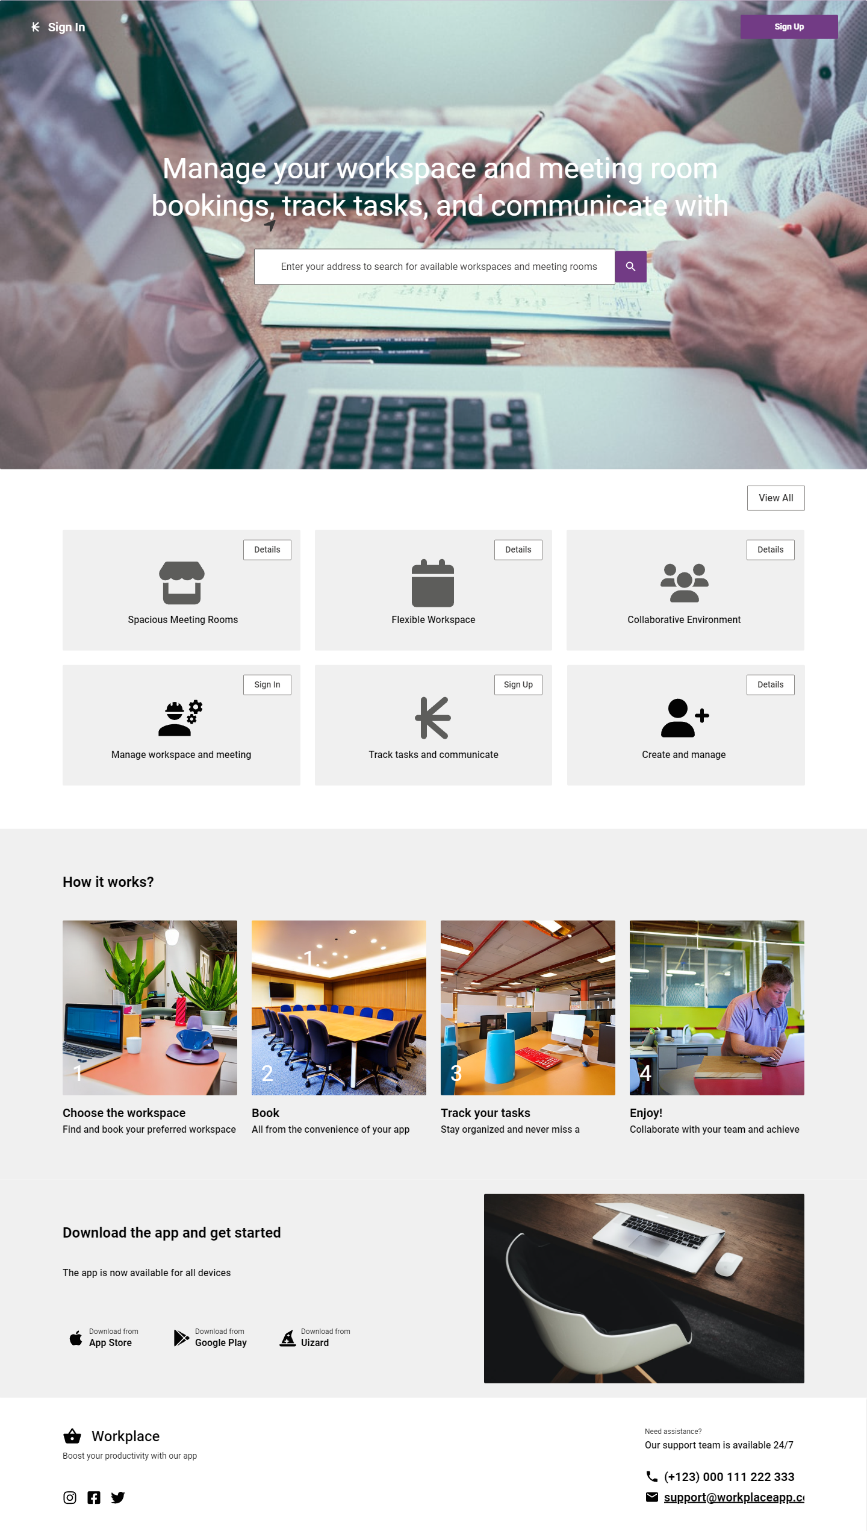
-THE HOME PAGE-

Slide 3
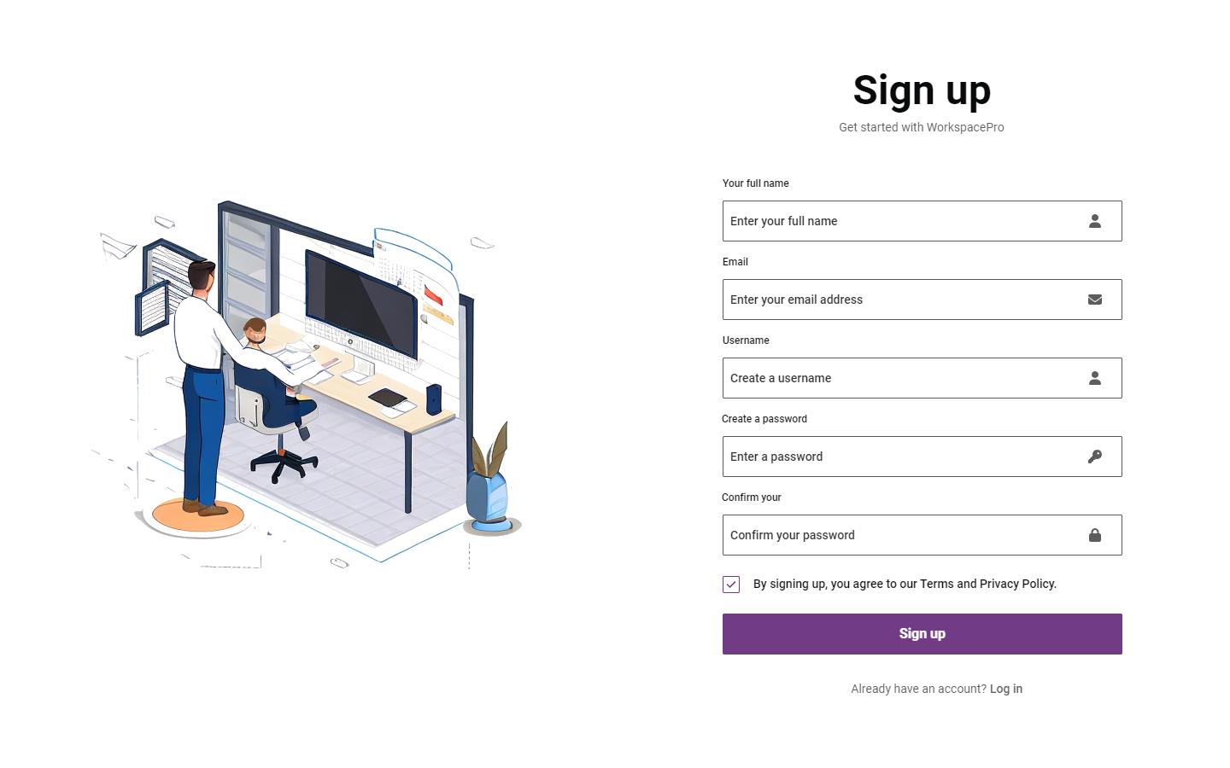

Slide 4
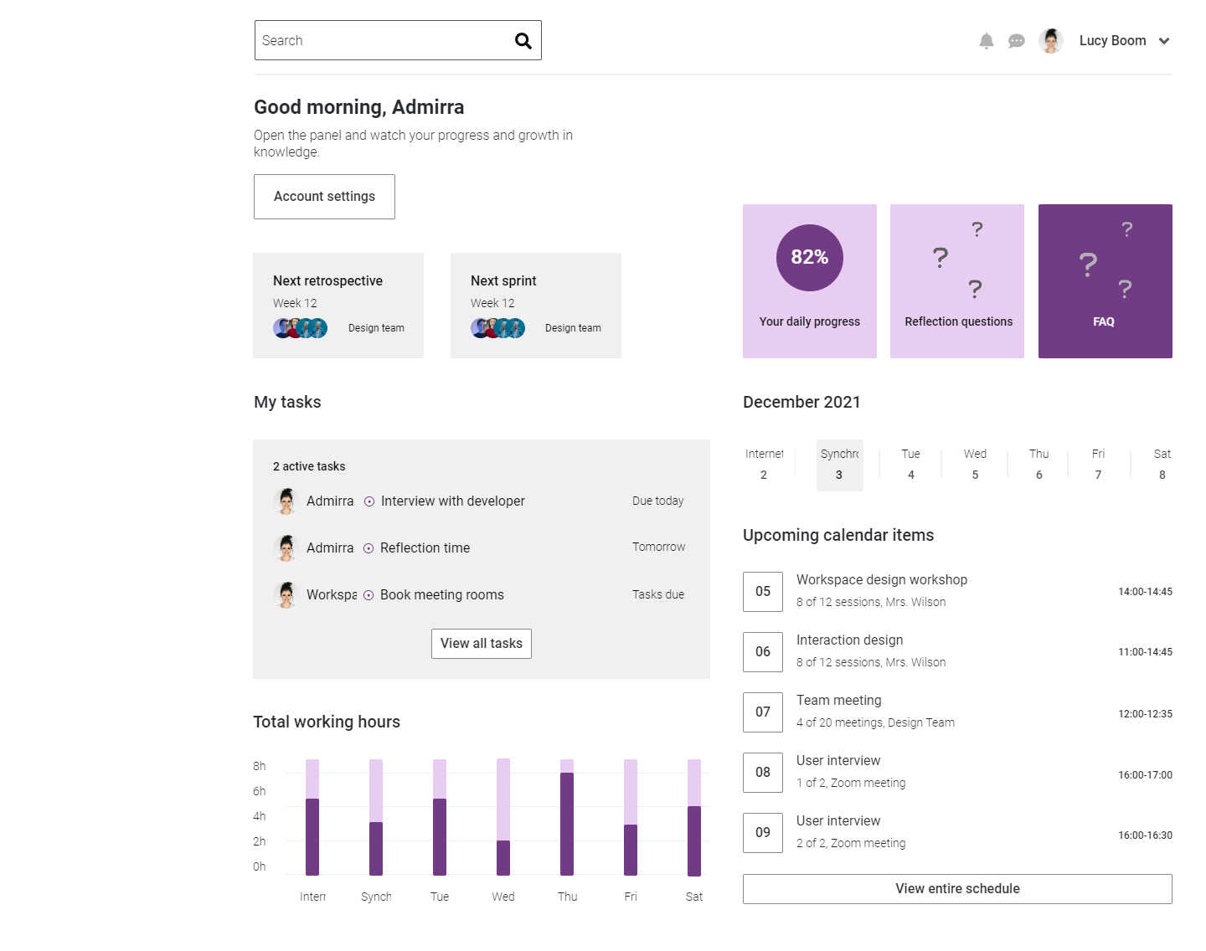
User Account page
For both normal users and Admins.

Slide 5
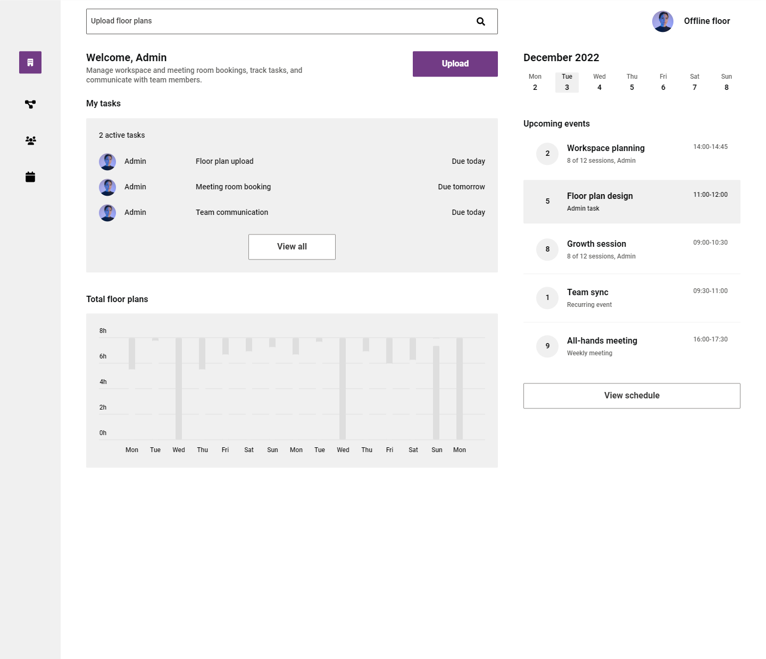
ADMIN PAGE
*Note: This works even when the network’s off.

Slide 6
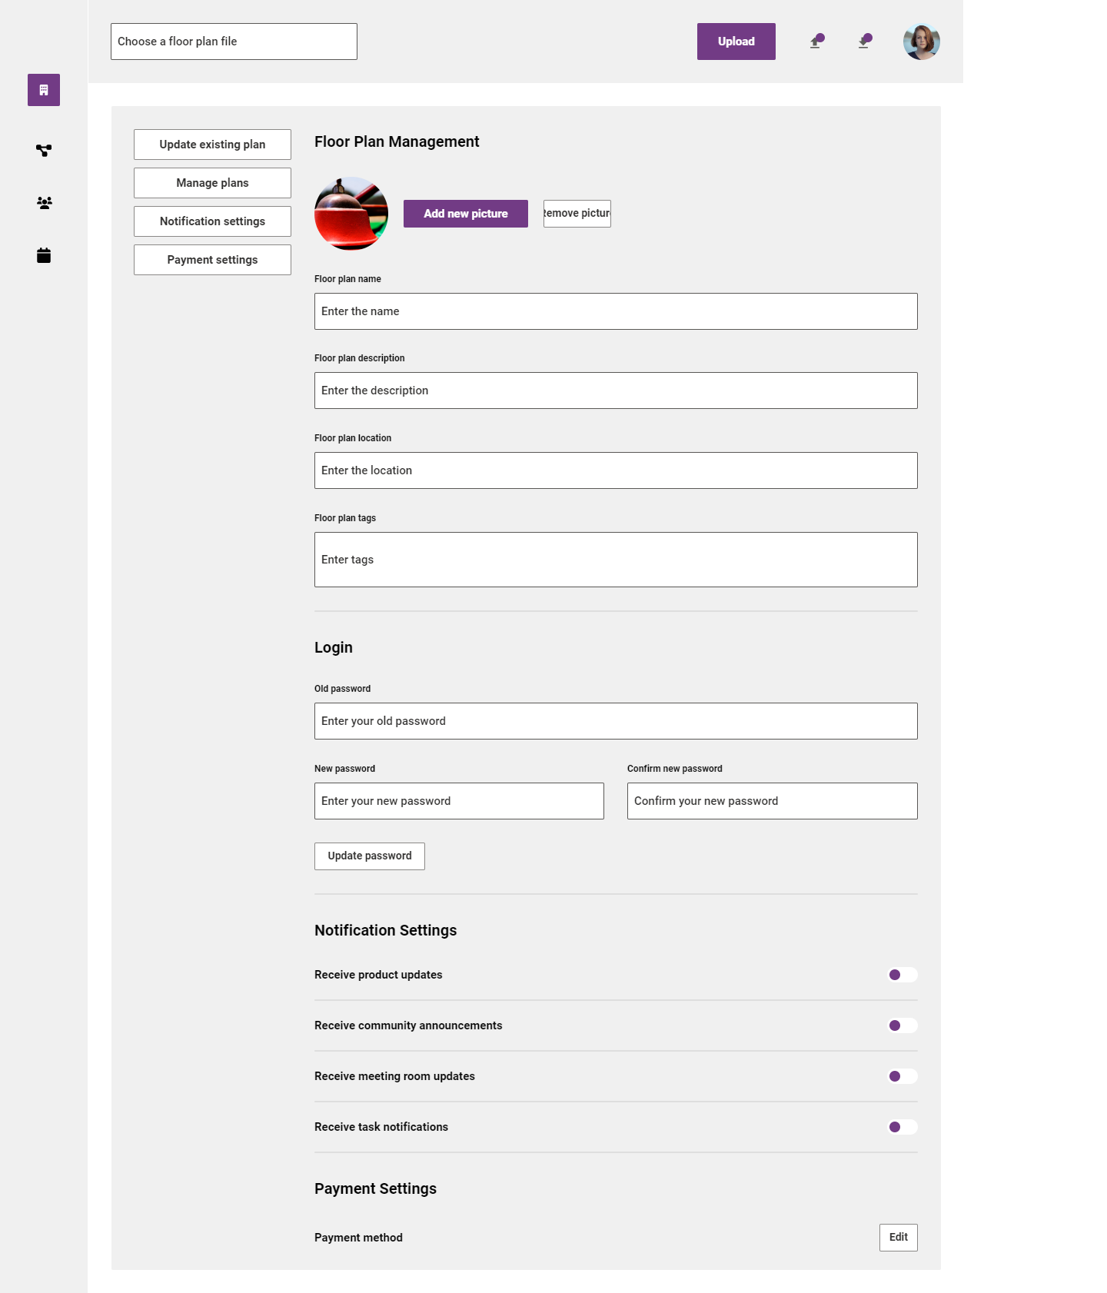
Admin Page to add New floor plans and options of viewing and modifying existing plans.

Slide 7
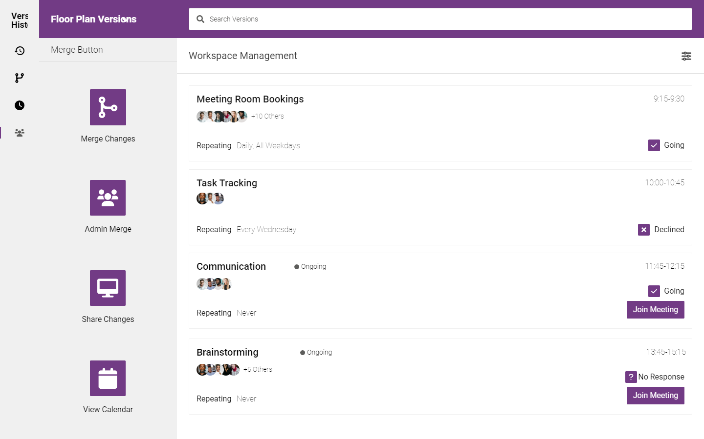
Admin page to modify & merge floor plans and view meeting room bookings.

Slide 8
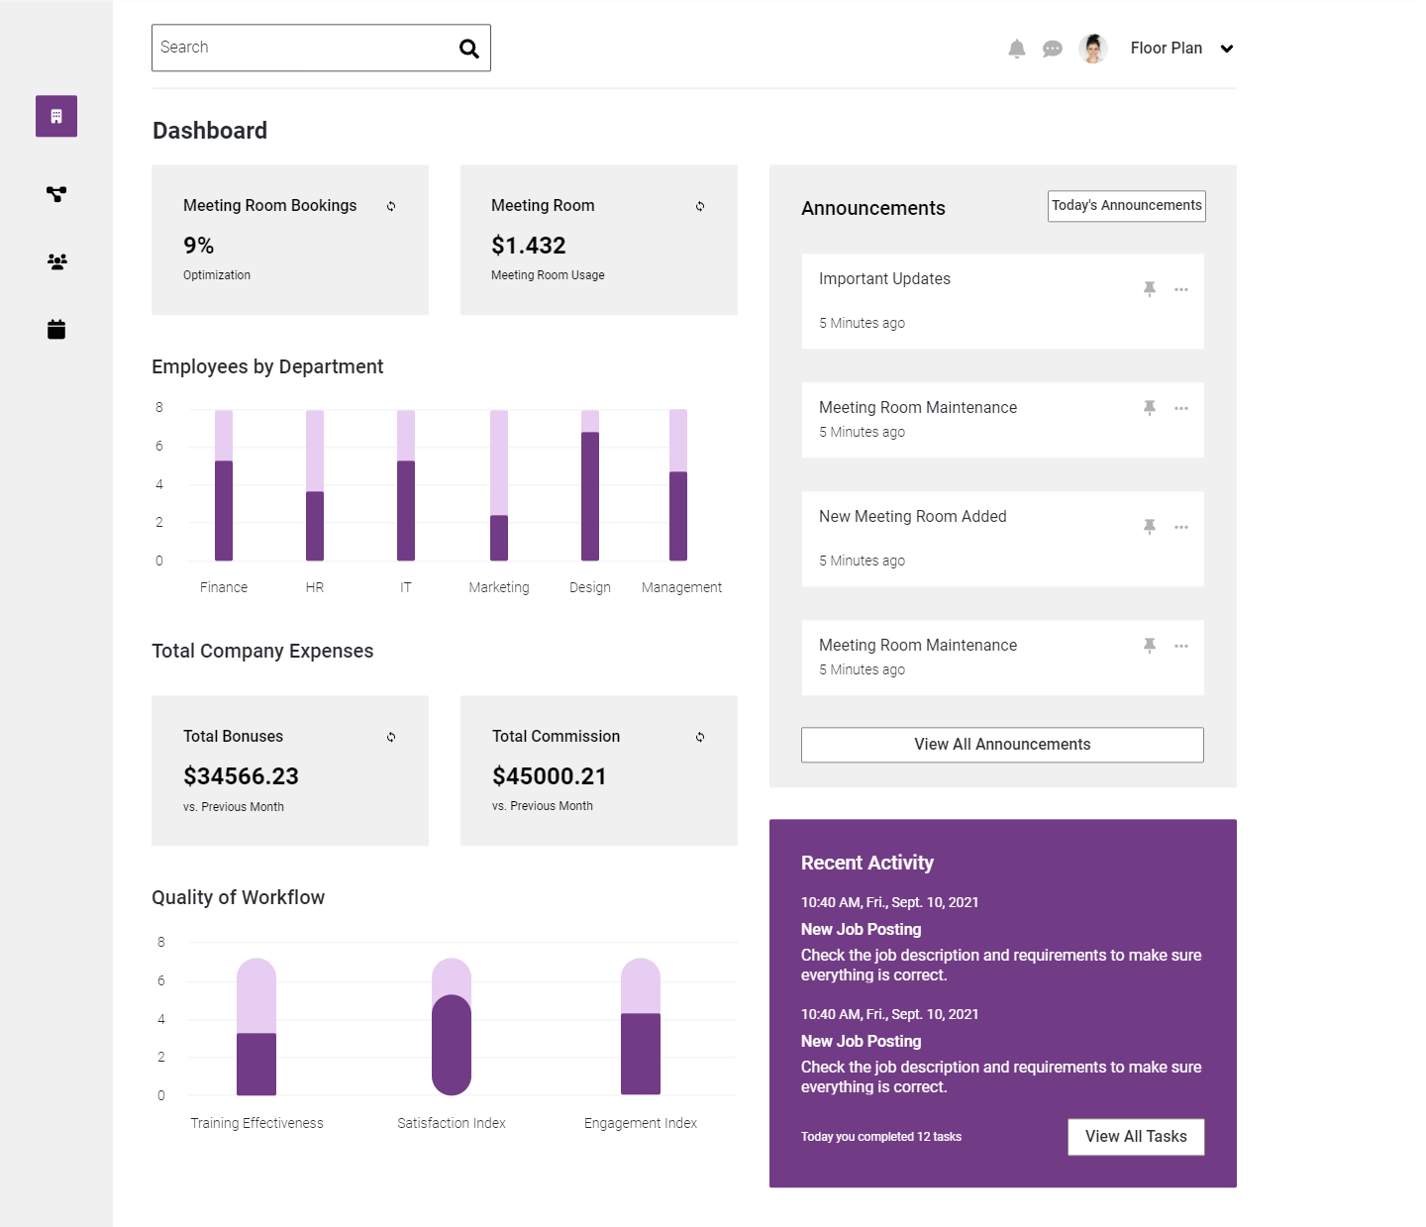
Dashboard for Meeting room bookings

Slide 9
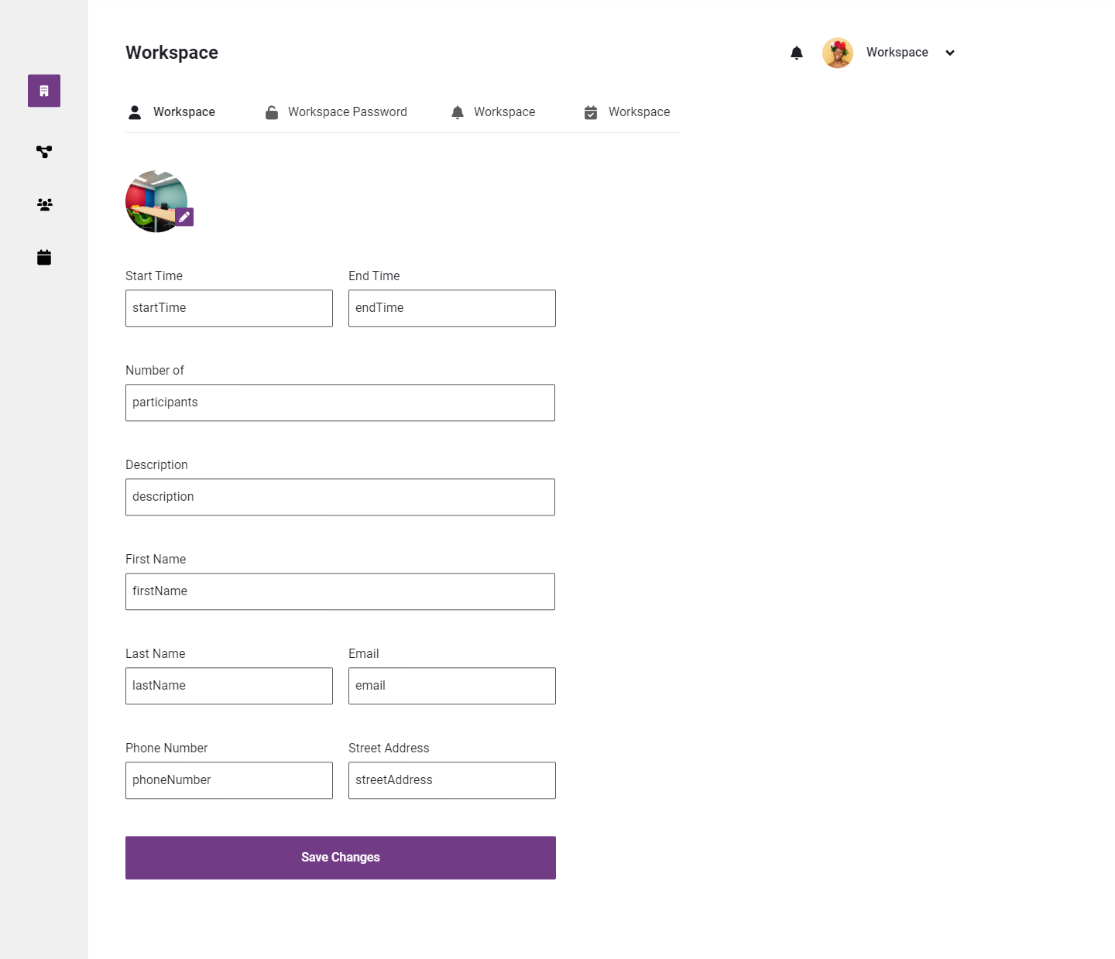
Form to book meeting room.

Slide 10
KEY POINTS
Home page allows you to have a look at basic features which doesn’t force you to login or signup.
After signing in, it redirects you to your account page shown in 4th slide.
If you have admin access, in the dropdown on top right corner has and admin button which takes you to admin page shown in 5th slide.
You can see on top right corner of admin page, it says offline floor, this indicates that the network’s off at this point. This reflects that the page works on offline even.
Being an Admin allows you to upload floor plans which is done by pressing the button on 5th slide.
That then redirects you to the page on 6th slide which asks for info on the plan and it also allows you to modify and view existing plans.
Upon pressing the modify button, it takes you to the page on 7th slide.
The 7th slide has the version control system which allows you to merge the modified plans and some more functionalities.
The page on 8th slide has the dashboard on meeting room bookings info.
You can book a meeting room by pressing on the book room button on the dropdown on top right corner again.
That takes you to the page on 9th slide where you can book a meeting room by giving all the timings and other basic info of meeting room.

